Slide 1
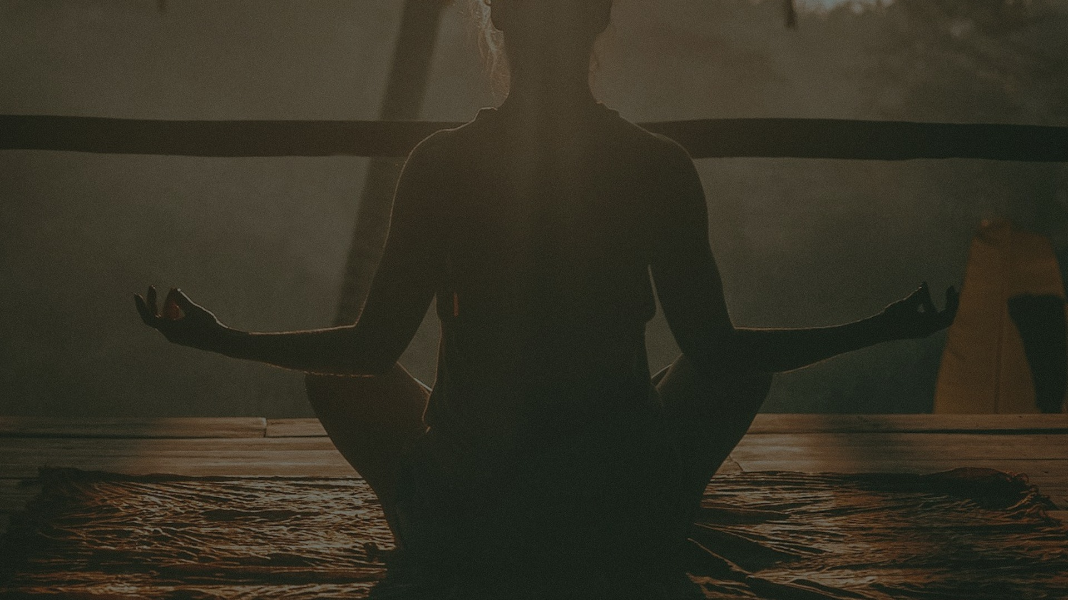
MINDFUL LIVING
A Holistic Guide to Conscious Wellness
Nature · Sunlight · Movement · Whole Foods · Hydration Meditation · Yoga · Community · Presence
"The greatest wealth is health." — Virgil
Inspired by Dr. Sebi · Dr. Robert Morse · Dr. Mark Hyman · Eckhart Tolle
Notes:
SLIDE 1 — COVER
Welcome your audience warmly. This presentation explores 9 pillars of holistic wellness drawn from ancient wisdom and modern science. Emphasize that these are interconnected practices, not isolated tips. Set the tone: this is a journey inward as much as outward.

Slide 2
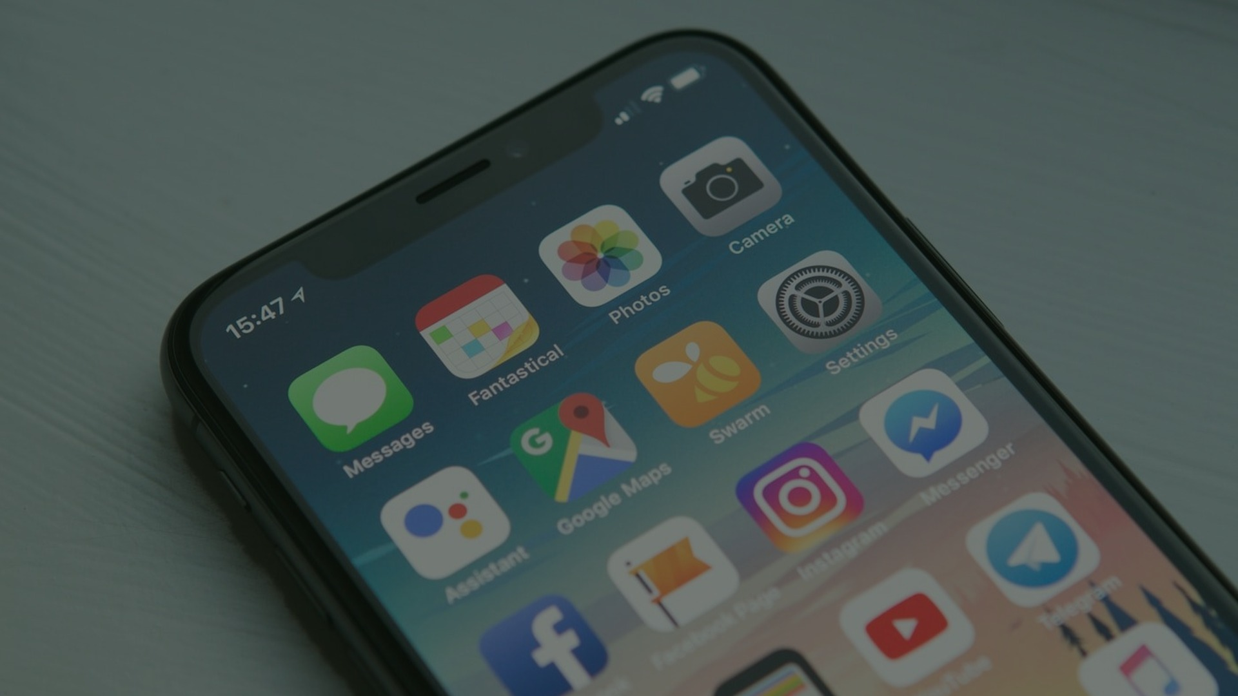
01
NATURE & GROUNDING
"In every walk with nature, one receives far more than he seeks." — John Muir
PRACTICE: Walk barefoot on grass or soil for 20 minutes daily. Touch trees. Sit by water. Let nature recalibrate your nervous system.
🌿 Earthing reduces cortisol & inflammation (Journal of Environmental & Public Health, 2012)
🌿 Forest bathing (Shinrin-yoku) lowers blood pressure & boosts NK immune cells
🌿 30 min in nature daily reduces anxiety by up to 28% (Mind UK study)
🌿 Negative ions from soil & plants elevate serotonin levels
🌿 Dr. Sebi: 'The body heals itself when returned to its natural environment'
Notes:
SLIDE 2 — NATURE & GROUNDING
Earthing/grounding research shows direct skin contact with the earth neutralizes free radicals. Shinrin-yoku (forest bathing) is now prescribed by doctors in Japan and South Korea. Encourage audience to start with just 10 minutes outside barefoot. Dr. Sebi emphasized alkaline environments — nature is the ultimate alkaline reset.

Slide 3
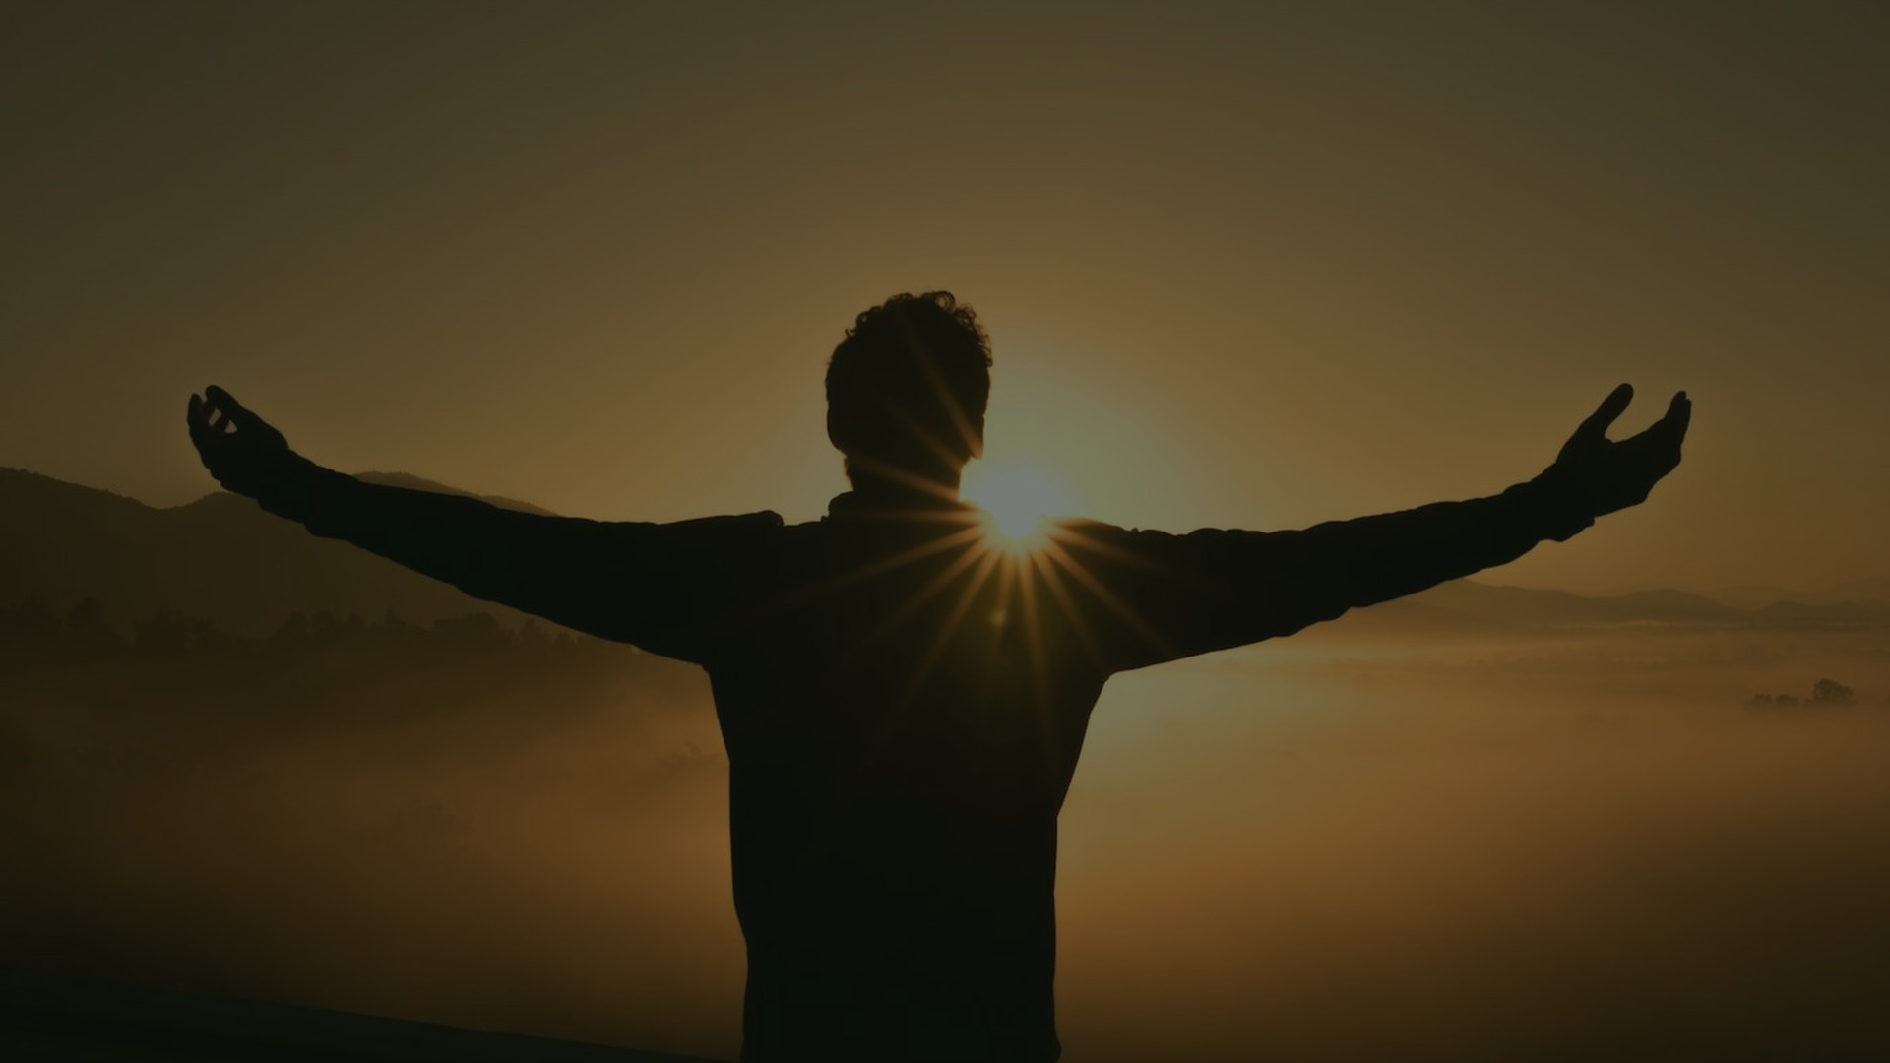
02
SUNLIGHT & VITAMIN D
"The sun is the source of all life. To deny it is to deny life itself." — Dr. Yahki Awakened
PRACTICE: Get 15–30 min of direct sunlight before 10am. No sunscreen during this window. Let your eyes receive natural light — it signals your entire hormonal system.
☀️ Vitamin D deficiency linked to depression, cancer, autoimmune disease & osteoporosis
☀️ Morning sunlight (6–9am) regulates circadian rhythm & melatonin production
☀️ 10–30 min of midday sun produces 10,000–20,000 IU of Vitamin D
☀️ Sunlight triggers nitric oxide release — lowers blood pressure naturally
☀️ Dr. Yahki: 'Melanin is activated by sunlight — it is our biological antenna'
☀️ Red light therapy (sunset spectrum) accelerates cellular repair
Notes:
SLIDE 3 — SUNLIGHT & VITAMIN D
Over 1 billion people worldwide are Vitamin D deficient. Dr. Michael Holick's research at Boston University shows sunlight is the most bioavailable source. Morning light exposure within 30 min of waking is key for cortisol/melatonin balance. Dr. Yahki Awakened emphasizes melanin's role as a superconductor activated by photons.

Slide 4
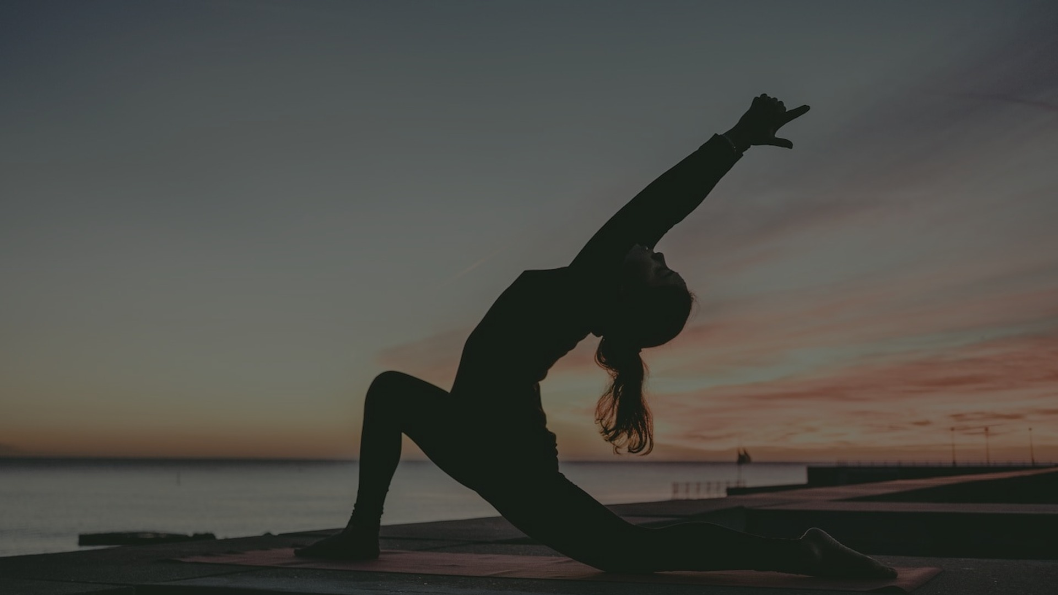
03
MOVEMENT & EXERCISE
"Movement is medicine for creating change in a person's physical, emotional, and mental states." — Carol Welch
PRACTICE: Walk 8,000–10,000 steps daily. Rebound 10 min morning. Stretch before bed. Dance. Swim. Move joyfully — not as punishment.
🏃 Exercise releases BDNF — 'Miracle-Gro for the brain' (Dr. John Ratey)
🏃 30 min of moderate exercise = 0.5mg of Prozac in antidepressant effect
🏃 Lymphatic system has NO pump — movement IS the pump
🏃 Rebounding (mini-trampoline) is 68% more efficient than jogging for lymph flow
🏃 Walking after meals reduces blood sugar spikes by up to 30%
🏃 Dr. Robert Morse: 'Stagnation is the root of disease — keep the lymph moving'
Notes:
SLIDE 4 — MOVEMENT & EXERCISE
The lymphatic system is critical for detoxification and immunity — it has no heart to pump it. Only muscular contraction moves lymph. Dr. Robert Morse's work on lymphatic stagnation as the root of chronic disease is compelling. Rebounding is particularly effective. Emphasize joyful movement over punishing exercise.

Slide 5

04
WHOLE FOODS & NUTRITION
"Let food be thy medicine and medicine be thy food." — Hippocrates
PRACTICE: Eat the rainbow. Prioritize fruits, leafy greens, sea vegetables. Eliminate processed foods, refined sugar, and hybrid foods. Cook with intention.
🥦 Whole plant foods contain 10,000+ phytonutrients — no supplement replicates this
🥦 Dr. Mark Hyman: 'Food is information that talks to your genes'
🥦 Dr. Sebi's alkaline food list: focus on electric foods that carry life force
🥦 Processed foods trigger neuroinflammation — linked to depression & cognitive decline
🥦 Fiber feeds gut microbiome — 95% of serotonin is produced in the gut
🥦 Raw fruits & vegetables retain enzymes destroyed by cooking above 118°F
Notes:
SLIDE 5 — WHOLE FOODS & NUTRITION
Dr. Sebi's alkaline/electric food philosophy centers on foods that are non-hybrid and carry electrical charge. Dr. Mark Hyman's Functional Medicine approach shows food as epigenetic information. The gut-brain axis research (Mayer, 2016) confirms 95% of serotonin is gut-produced. Emphasize food quality over calorie counting.

Slide 6

05
HYDRATION & WATER
"Water is the driving force of all nature." — Leonardo da Vinci
PRACTICE: Drink half your body weight in ounces of clean water daily. Start with 16oz upon waking. Add lemon, cucumber, or herbs. Avoid plastic bottles.
💧 The human body is 60–70% water — the brain is 75% water
💧 Even 1–2% dehydration impairs cognitive function & mood
💧 Dr. F. Batmanghelidj: 'You're not sick, you're thirsty' — chronic dehydration mimics disease
💧 Structured water (spring, glacier) has different molecular geometry than tap water
💧 Herbal teas, coconut water, and fresh fruit juices count toward hydration
💧 Avoid fluoridated tap water — fluoride calcifies the pineal gland
Notes:
SLIDE 6 — HYDRATION & WATER
Dr. Batmanghelidj's 'Your Body's Many Cries for Water' is a foundational text. His research showed chronic dehydration as the root of many 'diseases.' Masaru Emoto's water crystal research (while controversial) sparked important conversations about water consciousness. Emphasize spring or filtered water over tap.

Slide 7

06
MEDITATION & BREATHWORK
"You cannot always control what goes on outside. But you can always control what goes on inside." — Wayne Dyer
PRACTICE: 20 min meditation upon waking. Box breathing (4-4-4-4) before stressful events. Body scan before sleep. Start with 5 min and build.
🧘 8 weeks of mindfulness meditation physically thickens the prefrontal cortex (Harvard, 2011)
🧘 Dr. Joe Dispenza: meditation rewires neural pathways — 'neurons that fire together, wire together'
🧘 4-7-8 breathing activates the parasympathetic nervous system in 60 seconds
🧘 Jon Kabat-Zinn's MBSR reduces chronic pain, anxiety & depression by 40–50%
🧘 Transcendental Meditation reduces cardiovascular disease risk by 48% (AHA, 2012)
🧘 Dolores Cannon: deep meditation accesses the subconscious — the seat of healing
Notes:
SLIDE 7 — MEDITATION & BREATHWORK
Sara Lazar's Harvard study showed measurable brain changes after 8 weeks of meditation. Dr. Joe Dispenza's work on neuroplasticity and healing through meditation is well-documented. Wim Hof's breathwork research shows immune system modulation. Dolores Cannon's QHHT work suggests the subconscious mind holds the blueprint for perfect health.

Slide 8

07
YOGA & BODY-MIND INTEGRATION
"Yoga is the journey of the self, through the self, to the self." — The Bhagavad Gita
PRACTICE: 20–30 min yoga daily. Sun salutations at dawn. Yin yoga before bed. Focus on breath-movement synchronization — this is where the magic lives.
🧘‍♀️ Yoga reduces cortisol by 25% and increases GABA (anti-anxiety neurotransmitter)
🧘‍♀️ Trauma is stored in the body — yoga releases somatic memory (Bessel van der Kolk)
🧘‍♀️ Regular yoga practice increases gray matter density in the brain
🧘‍♀️ Kundalini yoga activates the endocrine system — balances hormones naturally
🧘‍♀️ Yin yoga targets fascia — the connective tissue that holds emotional memory
🧘‍♀️ Pranayama (yogic breathing) increases lung capacity & oxygenates every cell
Notes:
SLIDE 8 — YOGA & BODY-MIND INTEGRATION
Bessel van der Kolk's 'The Body Keeps the Score' is essential reading — trauma lives in the body, not just the mind. Yoga is one of the few practices that addresses both simultaneously. Kundalini yoga's effect on the endocrine system is particularly powerful for hormonal balance. Emphasize consistency over intensity.

Slide 9
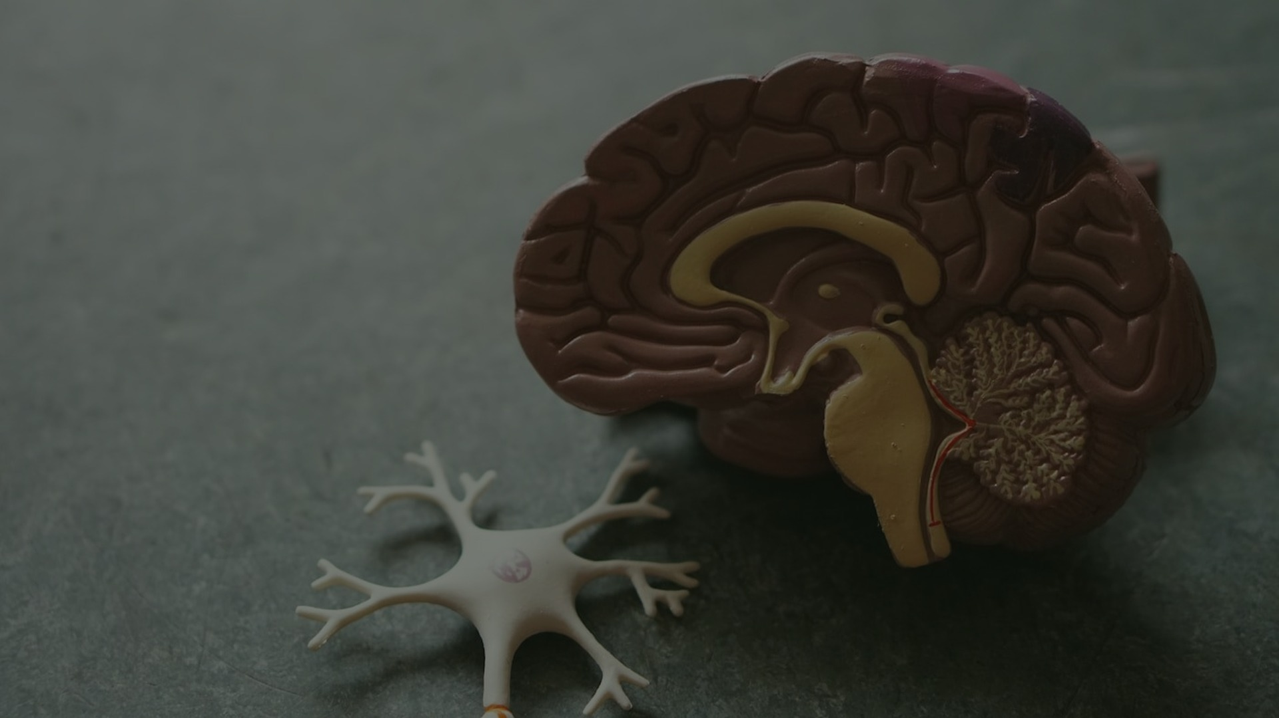
08
COMMUNITY & CONNECTION
"If you want to go fast, go alone. If you want to go far, go together." — African Proverb
PRACTICE: Cultivate 3–5 deep relationships. Join a wellness community. Practice active listening. Hug more. Serve others. Your healing is collective.
🤝 Loneliness is as harmful as smoking 15 cigarettes/day (Holt-Lunstad, 2015)
🤝 Strong social bonds increase longevity by 50% — the #1 factor in Blue Zones
🤝 Oxytocin (the 'love hormone') released through touch, eye contact & shared laughter
🤝 Ram Dass: 'We are all just walking each other home' — service heals the giver
🤝 Collective healing circles amplify individual healing — group coherence is real
🤝 Volunteering reduces mortality risk by 22% (Corporation for National Service, 2007)
Notes:
SLIDE 9 — COMMUNITY & CONNECTION
The Blue Zones research (Dan Buettner) consistently shows social connection as the #1 longevity factor — more than diet or exercise. Julianne Holt-Lunstad's meta-analysis of 148 studies confirmed loneliness as a major mortality risk. Ram Dass's teachings on service and connection are deeply relevant here.

Slide 10
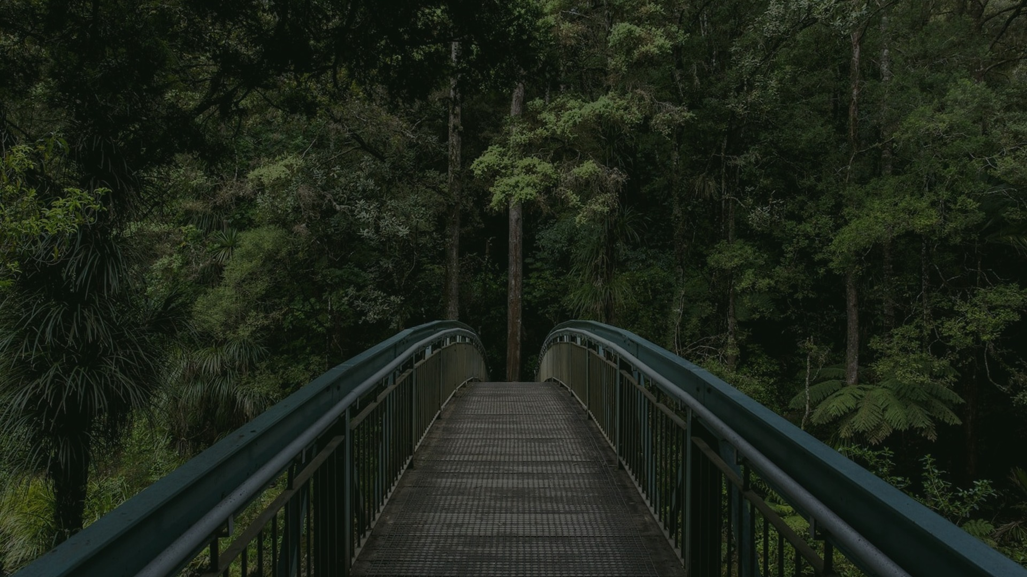
09
PRESENCE & CONSCIOUS LIVING
"Realize deeply that the present moment is all you ever have." — Eckhart Tolle, The Power of Now
PRACTICE: Phone-free mornings. Eat without screens. Take 3 conscious breaths before each meal. Keep a gratitude journal. Notice beauty in ordinary moments.
🌸 The average person spends 47% of waking hours mind-wandering (Harvard, 2010)
🌸 Eckhart Tolle: the 'pain body' feeds on unconscious reactivity — presence dissolves it
🌸 Thich Nhat Hanh: 'The present moment is the only moment available to us'
🌸 Mindful eating reduces overeating by 40% and improves digestion significantly
🌸 Digital detox for 24 hours reduces cortisol levels measurably (University of Surrey)
🌸 Gratitude practice rewires the brain toward positivity in 21 days (Shawn Achor)
Notes:
SLIDE 10 — PRESENCE & CONSCIOUS LIVING
Killingsworth & Gilbert's Harvard study showed mind-wandering correlates with unhappiness regardless of activity. Eckhart Tolle's concept of the 'pain body' — accumulated emotional pain that perpetuates itself — is dissolved through present-moment awareness. Thich Nhat Hanh's interbeing philosophy connects presence to ecological consciousness.

Slide 11
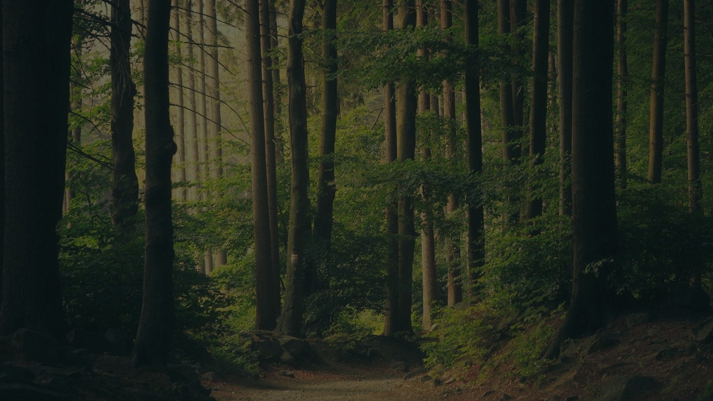
THE 9 PILLARS OF MINDFUL LIVING
🌿 Nature
☀️ Sunlight
🏃 Movement
Ground daily. Touch earth.
Morning light. Vitamin D.
Move lymph. Move joy.
🥦 Whole Foods
💧 Hydration
🧘 Meditation
Electric. Alkaline. Alive.
Half weight in oz. Clean water.
20 min daily. Rewire mind.
🧘‍♀️ Yoga
🤝 Community
🌸 Presence
Breath + body. Release trauma.
Deep bonds. Serve others.
Now is all. Be here.
"Health is not merely the absence of disease — it is the full expression of life."
Notes:
SLIDE 11 — THE 9 PILLARS SUMMARY
This is your synthesis slide. Walk through each pillar briefly. Emphasize that these are not separate practices but an integrated lifestyle. The pillars reinforce each other — better sleep improves nutrition choices, movement enhances meditation, community supports all practices. Invite the audience to choose ONE pillar to focus on this week.

Slide 12
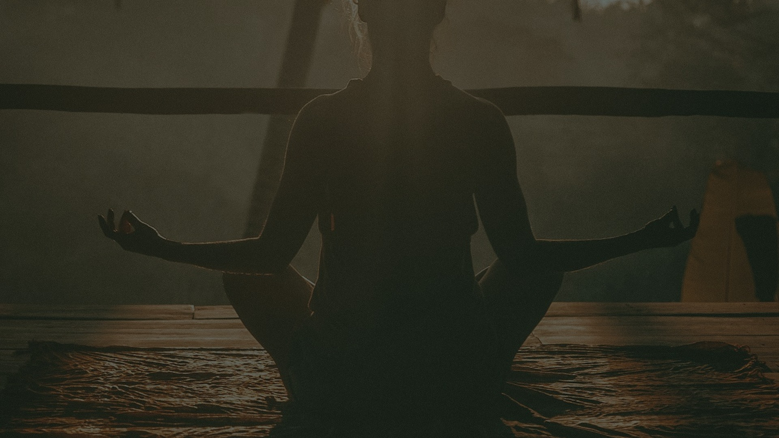
YOUR JOURNEY BEGINS NOW
"The secret of getting ahead is getting started." — Mark Twain
✦ Choose ONE pillar to begin with this week
✦ Stack habits gradually — add one new practice each month
✦ Journal your journey — awareness accelerates transformation
✦ Find your community — healing is amplified in collective
✦ Be patient and compassionate with yourself — this is a lifelong practice
"You are the medicine. You are the healer. You are the miracle." — Dr. Joe Dispenza
Notes:
SLIDE 12 — CLOSING
End with energy and inspiration. Remind the audience that wellness is not a destination but a daily practice of returning to wholeness. The body has an innate intelligence — our job is to stop interfering with it and start supporting it. Leave them with one actionable step they can take TODAY.

